Slide 1

Allison Chin, Liam Kopp, Kaijie Zhang, Sadman Sakib
Notes:
Good morning, we are Alli, Kaijie Sadman and myself, Liam.
Here today to talk to you about our device, eHIT
A concussion diagnostic aid for sports

Slide 2
PRESENTATION OUTLINE
Introduction
System overview
Hardware
Software
Conclusion
Challenges
Next steps
Notes:
Introduction – Introduce the device and our original design, and then explain where we are currently
Hardware – Alli is going to explain the hardware side of our project in more detail
Software – Then Sadman will explain the software side in more detail
Conclude and next steps – Kaijie will conclude our presentation with challenges and next steps

Slide 3
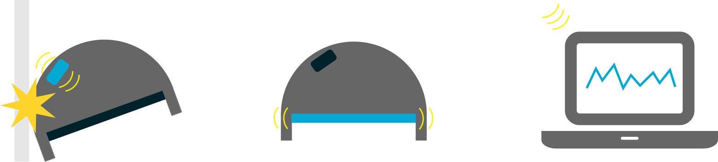
INTRODUCTION
EEG Head Injury Tool
1. Sensing
2. EEG
3. Monitoring
Notes:
eHIT, formerly known as eCATS stands for…
EEG Concussion Assessment Tool for Sport
Now let’s break that down some more. Our original design had three parts. The first one is
Sensing
There is some sensing unit that detects impact.
2.
The Second component is the EEG.
Our idea was to have the EEG attached to a Headband inside helmet so that the electrodes can fit snugly against the head.
3. That brings us to the third step
Being able to Wirelessly Monitor the user from the sideline with a laptop or cell phone.
And now combining these steps together – Sensing, EEG and monitoring, our End goal is to help diagnose concussion by analyzing EEG data immediately after an impact is sensed.

Slide 4
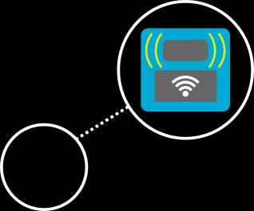

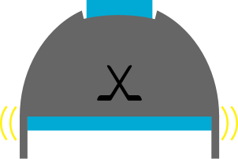
SYSTEM OVERVIEW
1. Sensing + EEG
2. Monitoring
Notes:
Now this is what our design currently looks like:
- We decided to tailor our design towards a hockey Helmet.
- The EEG component works fine inside a headband
-we decided to put the sensing unit on the top of the helmet because there is more space
Our Sensor unit is made up of an accelerometer and a WiFi module
Wifi module allows us to send the data wirelessly to a laptop with python libraries installed to collect the data and display it graphically
And now Alli is going to go over the hardware of our design

Slide 5
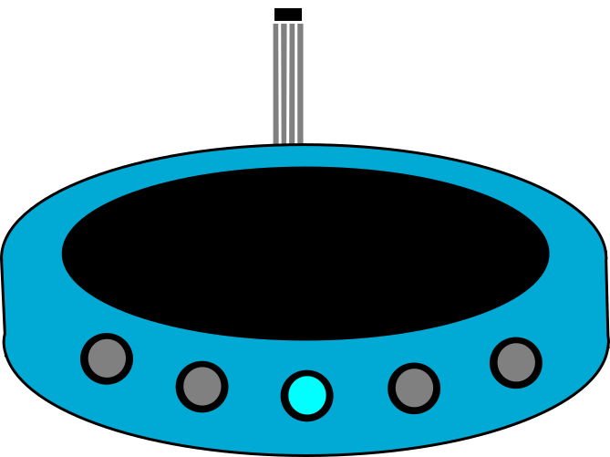
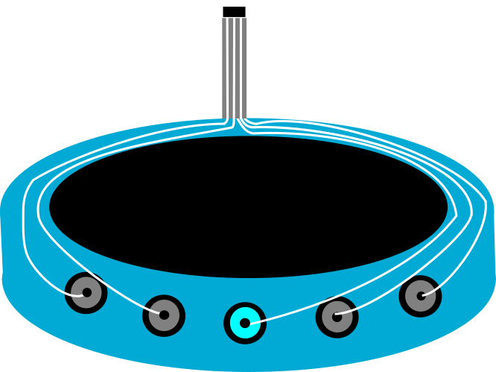
HARDWARE
Disc electrodes weaved inside headband
Ribbon cable used to reduce motion artifacts
Notes:
Disc electrodes weaved inside headband
Two differential inputs taken from the forehead with the ground electrode in the middle of the forehead. Electrodes decided are silver/silver chloride disc electrodes. The leads are weaved inside the headband to prevent motion artifacts and to protect the leads.
Ribbon cable used to reduce motion artifacts
The ribbon cable goes through the helmet to connect to the device on the top of the helmet. This will also help reduce motion artifacts and protect the hardware.

Slide 6
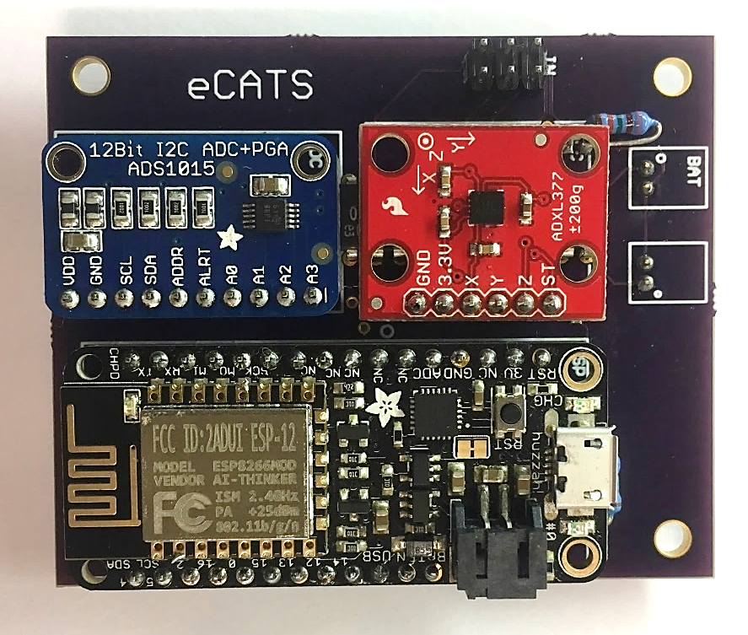
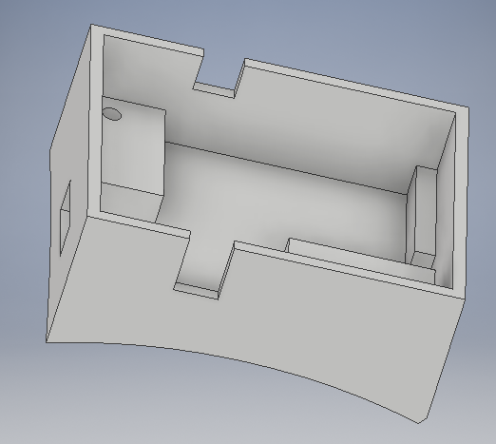
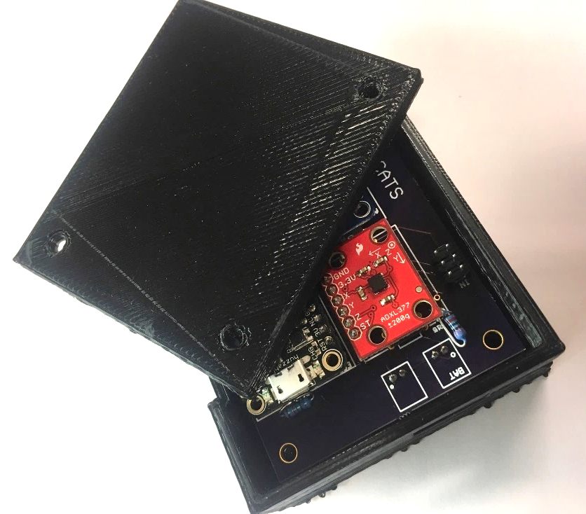
HARDWARE
Analog filter and gaining circuit
Custom PCB
Implementation of battery powered components
Notes:
Analog filter and gaining circuit
For the input to be read by the ADC the signal must be amplified and gained. We designed a circuit that gains the signal and filters out the noise and then level shifts signal for the ADC.
Custom PCB and enclosure
This circuit was implemented by printing a custom circuit board with very small surface mount components to allow our device to be very compact. We also designed a custom enclosure that we 3D printed. This allowed us to custom create the correct input holes and save space.
Implementation of battery powered components
The device is completely battery powered to allow it to be wireless. We are using 3 lithium ion batteries that are placed inside the helmet for protection and space efficiency.

Slide 7
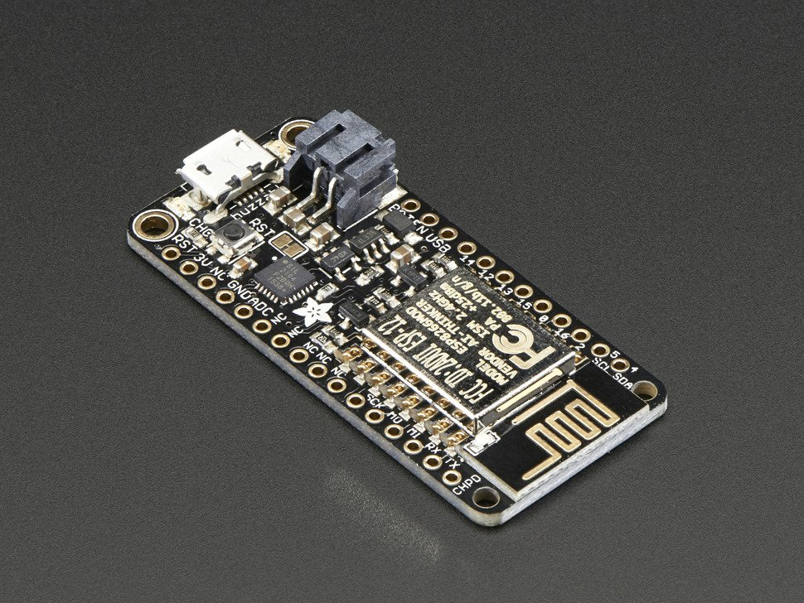
MICROCONTROLLER
ESP8266 Feather HUZZAH
Lightweight and small
Built-in WiFi
I2C for data transfer
Samples data from accelerometer and two differential electrode inputs
Data is transferred to remote computer by setting up as a WiFi client

Slide 8
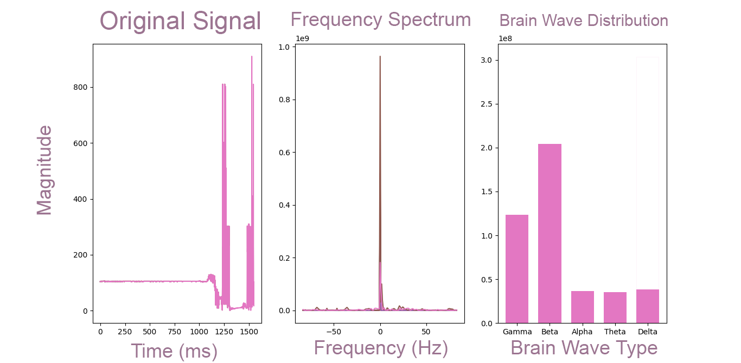
SOFTWARE
Use Python script for real-time analysis of EEG data
Continuously record data coming from microcontroller
Establish a baseline EEG sample
Compare post-impact EEG data with baseline EEG data
Send out warning if there is significant change in EEG pattern

Slide 9
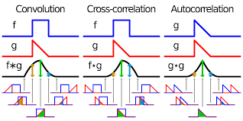
SOFTWARE
Baseline EEG and post-impact EEG is compared by looking at signal power spectral density
Code performs Fourier transform on signals
Perform cross correlation of the two Fourier transforms to determine similarity/deviation

Slide 10
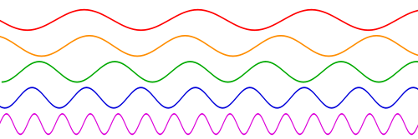
CHALLENGES
Matching dimensions of 3D print to helmet
Variability in data amongst users
Sending data in real-time → Need fast ping rate

Slide 11

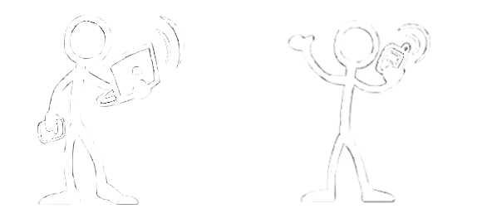
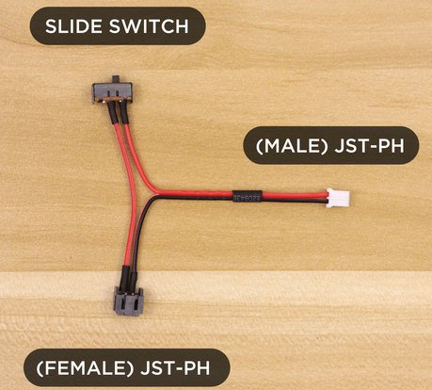
NEXT STEPS
Testing helmet for new concussion data
Implement a switch
Mobile application

Slide 12


FUTURE GOALS
Make it even smaller!
Implement multiple devices on one field
Design for a variety of sports
Notes:
Making it smaller: can take out breakout boards, and can design with lithium ion button cells, instead of lithium polymer. Lithium polymer is for the breakout boards, so with lithium ion, can significantly decrease the size, and also increase safety for the user.

Slide 13
THE END?

